Slide 1
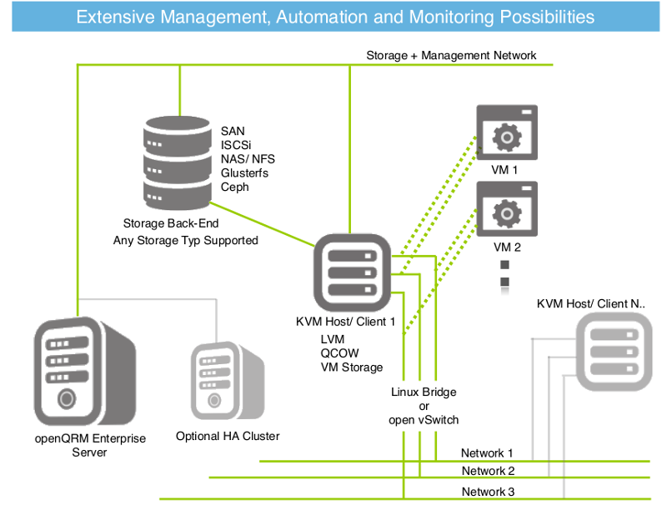
Virtual Machines
Kernel-Based Virtual Machine

Slide 2
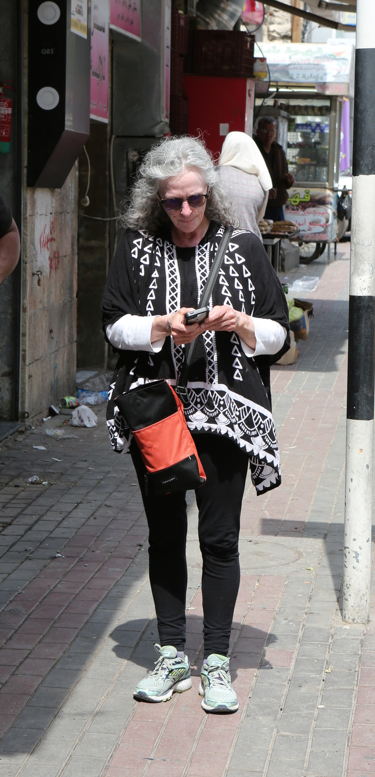
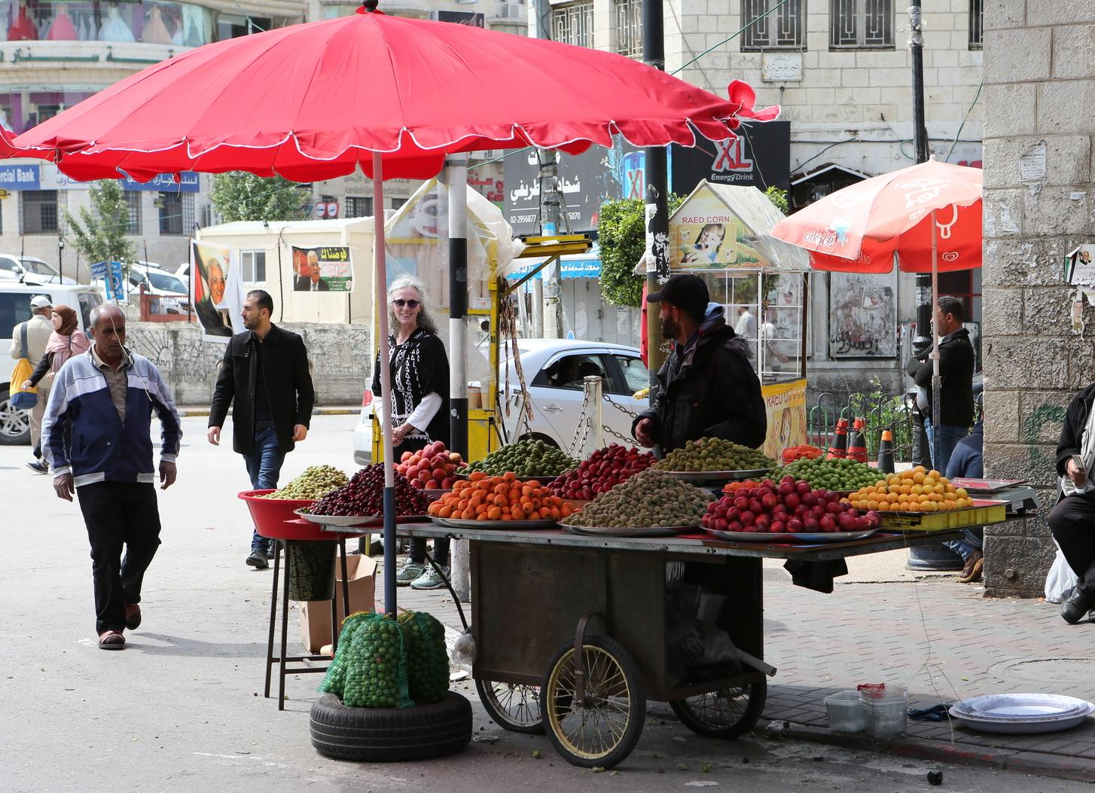

Slide 3
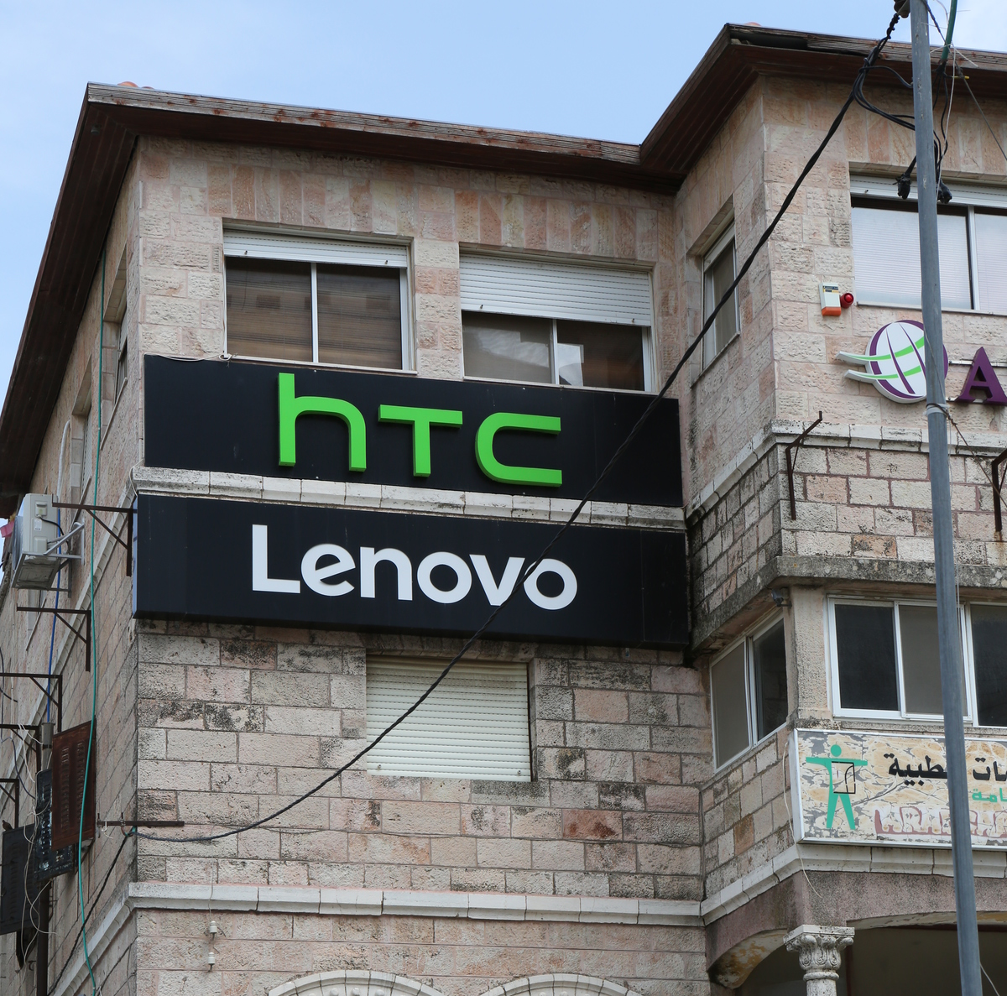
High
Throughput
Computing

Slide 4
Disabling User List on GUI Login Screen
Please updated Puppet Configuration for GUI
file { 'gnome_login_screen':
path => '/etc/dconf/db/gdm.d/00-login-screen',
ensure => 'present',
} ->
file_line { 'org_gnome_login_screen':
path => '/etc/dconf/db/gdm.d/00-login-screen',
line => '[org/gnome/login-screen]',
} ->
file_line { 'disable_user_list':
path => '/etc/dconf/db/gdm.d/00-login-screen',
line => 'disable-user-list=true',
after => '\[org/gnome/login-screen\]',
multiple => false,
notify => Exec['dconf'],
}
exec {'dconf':,
command => '/usr/bin/dconf update',
}

Slide 5
Accepting EULA in Kickstart
The following is supposed to disable the system service that requires accepting the license after installing the GUI:
systemctl disable initial-setup-graphical.service
I have not tested it. Can you add it to the gnome-desktop?
Puppet module

Slide 6
My concerns:
I am concerned that we are getting a bit fragmented?
How can we bring the class back together?
How can we wrap up the current work and start working on the class server?
Propose we configure 6 drives for RAID 6 => About 16TB of storage
Put 1 drive on the shelf for a spare
Install KVM on central machine
Start installing Cobbler and Puppet on VMs on central machine
Can we do this in the next 2 weeks and then start using the system and preparing for a workshop in June?
Do you think we can invite back the people who stopped coming?
You can practice teaching HTC by teaching them.

Slide 7
Kernel Virtual Machine
KVM is a full virtualization solution for Linux on x86 hardware.
KVM can run multiple virtual machines running unmodified Linux or Windows images.
Each virtual machine has private virtualized hardware: a network card, disk, graphics adapter, etc.
Virtual Machines are like adding additional hosts for free.
https://en.wikipedia.org/wiki/Kernel-based_Virtual_Machine

Slide 8
Class 17 Agenda: Virtual Machines
Date: May 3, 2018 Objective: Create and run KVM Virtual Machine Finish the previous HTCondor Tutorial Directed Acyclic Graphs Doing more on your own
Class 17 Slides: Class 17 - Virtual Machines
Support documents for the in-class work: DAGMan Applications HOWTOs Condor Submit File
In-class documentation: Class 17 - KVM: Virtual Machines

